Slide 1

The Artisan of Neural Networks
數位神經工匠
Together, we shape the future
Ver 2023.10
Notes:
Title - tbc

Slide 2
Information - Understanding
信息 理解
The Essence of the Universe is Information
宇宙的本質是信息
The Inherent Nature of Information is to Resolve Uncertainty
信息的本質是解決不確定性
- Claude Shannon’s Information Theory (香農 - 宇宙信息論)
2

Slide 3
The SPIRIT
靈 魂
Transcending the Limits of Intellect
超越思維極限
Reduce Loss, Promote Synergy, Deliver Intelligent Visibility
減少耗損、協同開放、智能可視
The WISDOM
智 慧
Information-Driven, Systems Thinking, Business Ecosystem
信息驅動、系統思維、商務生態
Breakdown Silos, Convergence (Omnichannel, Full Perceptions, Multi-Dimensional Space)
打破數據孤島、（全渠道 、全感知 、多維空間）智能融合
The Principle of Entropy 熵增定律
3

Slide 4
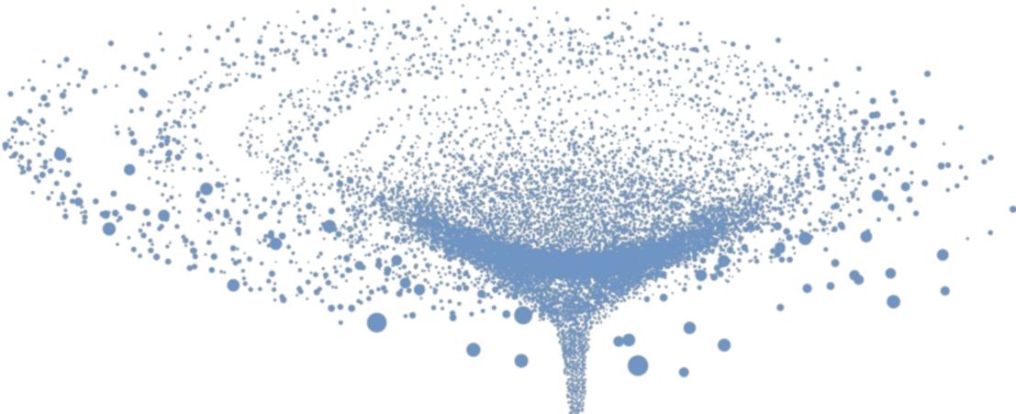

The eternal mystery of the world is its comprehensibility
這個世界最不可能理解之處是它竟然是可以理解
Forms of Information
信息形式 – 四維空間
Temporal-Spatial Curves
時空嵌入 ／時空曲綫
Time
時 間
Energy
能 量
- Albert Einstein 愛因斯坦
(ESG)
Information beyond a business’s grasp, CINNOX has the solution.
企業無法理解的信息, CINNOX 竟然都能解決
Matter
物 質
Space
空 間
The Soul Within
企 業 靈 魂
One of the Foundational Laws of Cosmology introduced by Albert Einstein
愛因斯坦宇宙學基礎定律之一
4

Slide 5

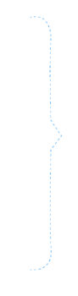


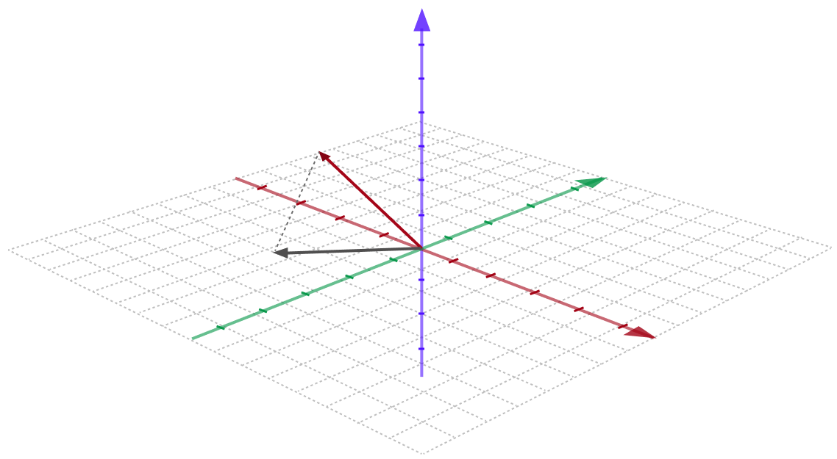
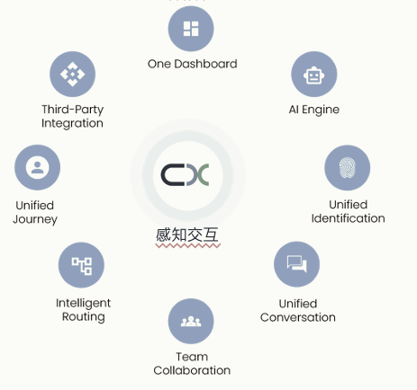



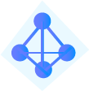




Connectivity & Ecosystem
連接 生態
1
Connect
連接
2
Orchestrate
協同
3
Intelligent Visibility
智能可視
4
Vector Data
向量數據
Data
數據
Identities, Connections
特徵、聯接
Telephony
電信
Correlations, Pathways
關聯、路徑
High-Dimensional Information
高維信息
Induction, Knowledge Base
歸納、智庫
Web-based
線上
Organize
組織
Understanding, Analytics
理解、分析
Space
空間
Matter
物質
Social & Email
社交及電郵
Visible, Intelligence
可視、智能
SDK
Perceptual Interaction
感知交互
Information Exchange
信息交互
Learning, Editing
學習、編輯
IoT
物聯網
Energy
能量
Time
時間
Discovery, Capturing
探索、捕獲
Insights, Innovations
洞察、創造
Information
信息

Slide 6

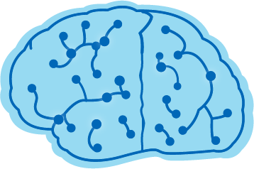
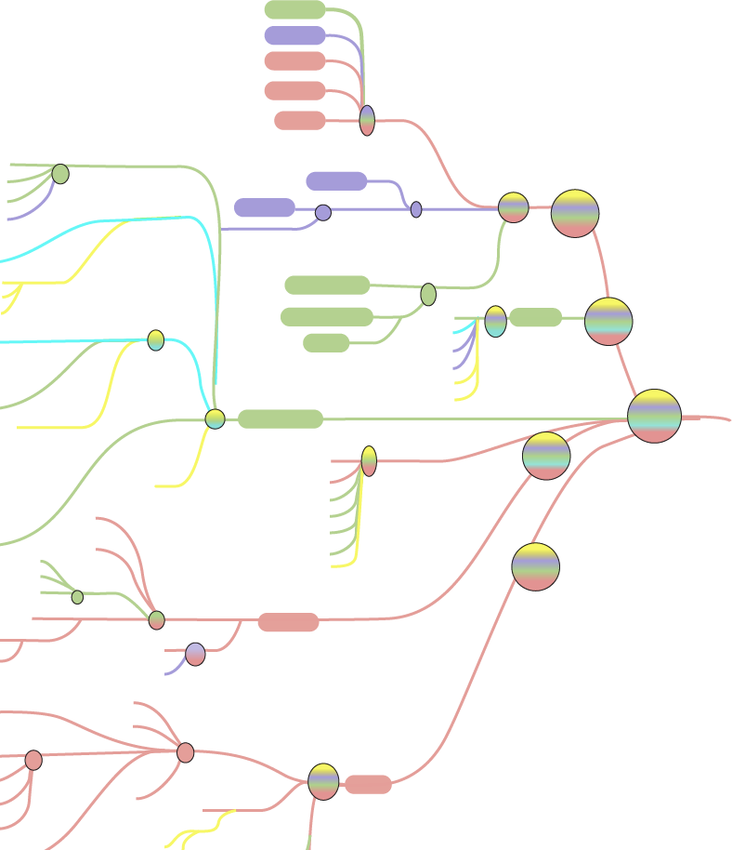
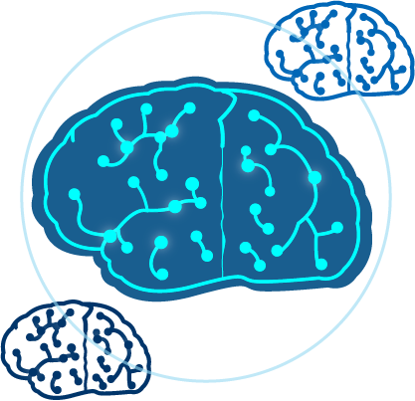
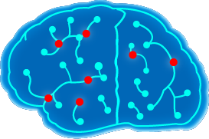
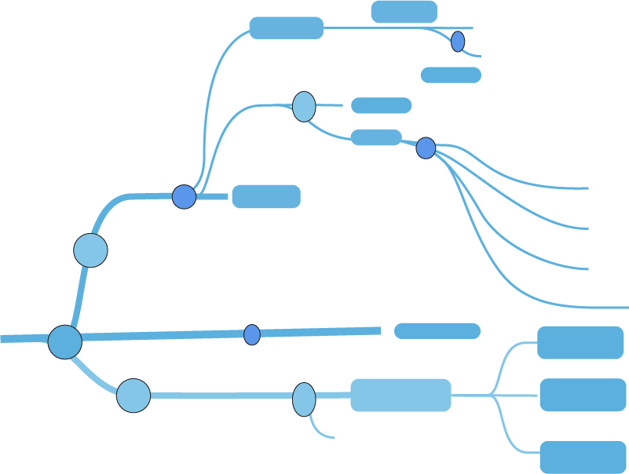
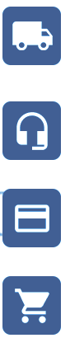

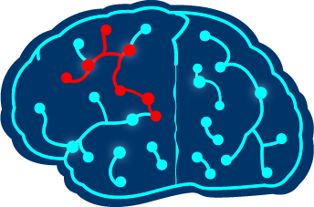
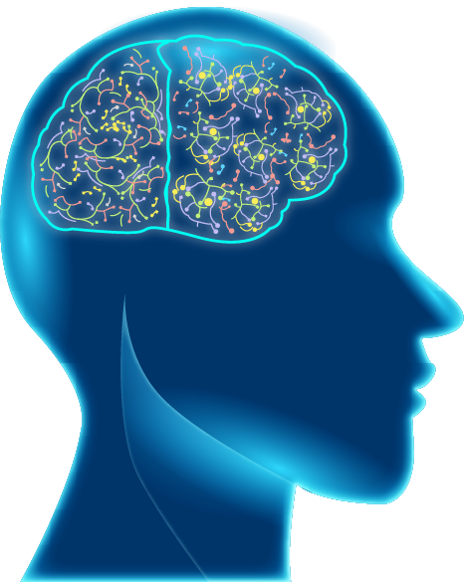
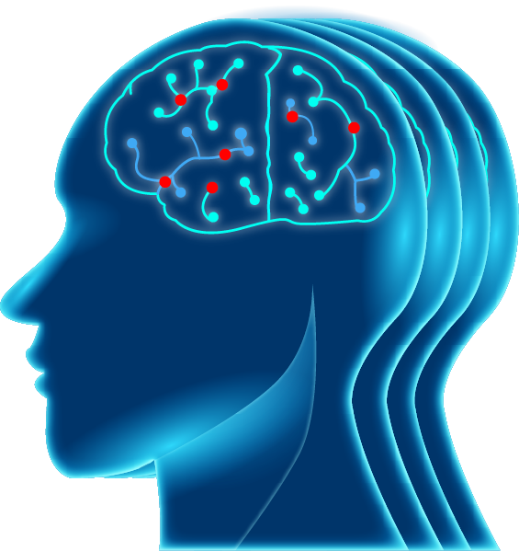

Systems Thinking and Transformation
系統思維 轉換
CINNOX
Open AI
OA Systems
Macro
宏 觀
Everlasting energy
不會消失的能量
Integrity
道 德
Individual
個 人
Relationships dictated by Cause & Effect (Causality)
通過效應需存在的恆定關聯 (因果性)
Vertical
行 業
Enterprise
企 業
Compliance
法 規
Objective
客 觀
Subjective
主 觀
Random Connections (Synchronicity)
偶然性的非恆定關聯 (共時性)
Continuity of time & space
時空連續
Customer
客 戶
Organisation
企 業
Input layer
感 知
Deep neural networks
(multiple hidden layers)
邏 輯 運 算
Output layer
認 知
Solution
方 案
Carl Gustav Jung
榮 格 定 律

Slide 7
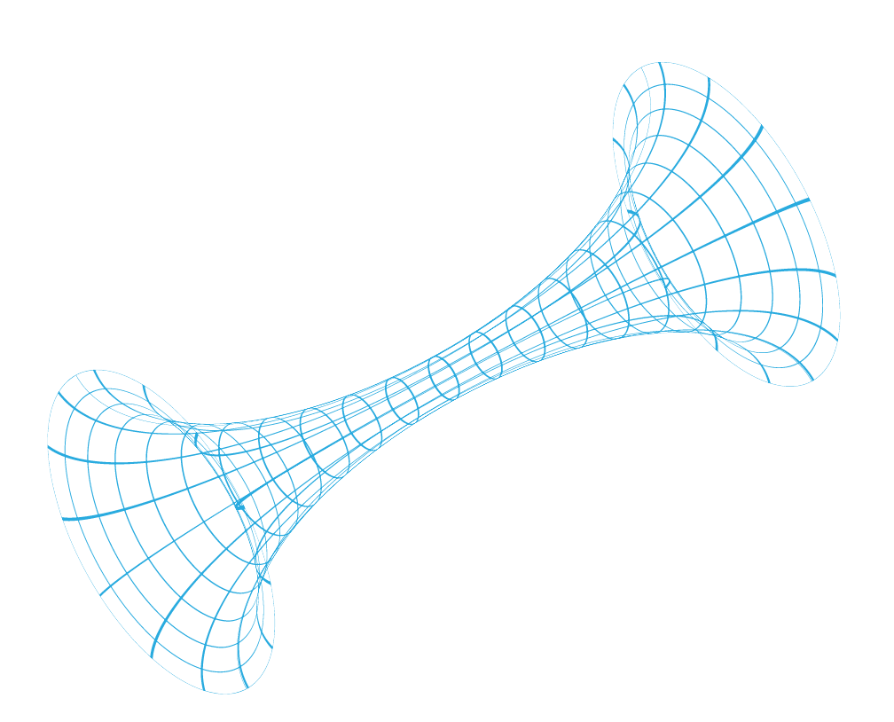
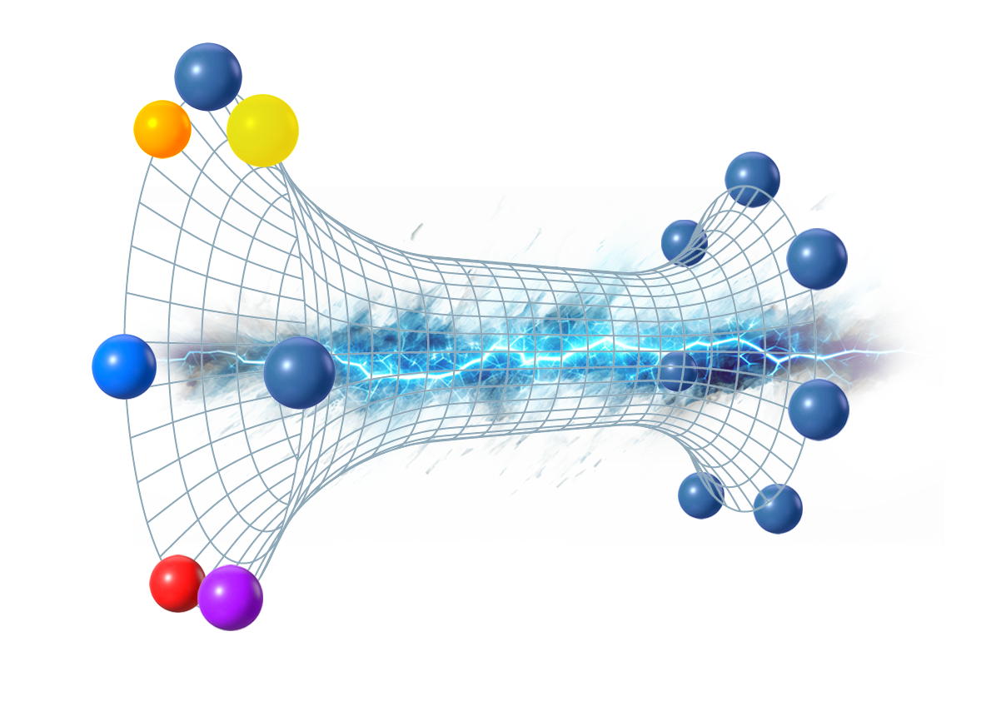




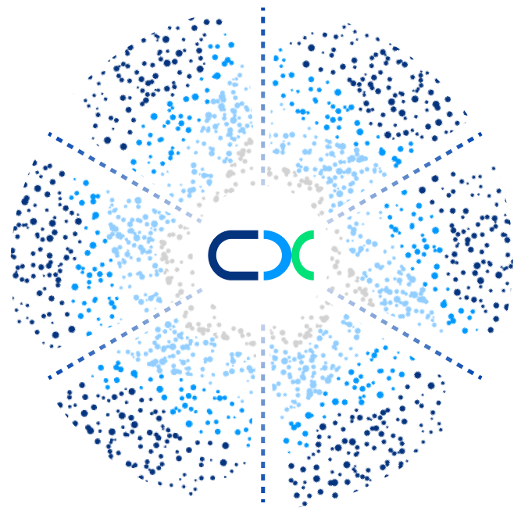







Physical Simulation of Human Cognition
物理模擬人類思維
Quantum State
量 子 態
Data
數 據
Information
+
Intelligence
信 息、智 能
Wormhole
蟲 洞
OUT
OA
IN
Connect
連 接 (關 聯)
Structure
組 織
Induction
歸 納
Energy
能 量 (運 動)
Orchestrate
協 同
Capabilities
功 能
Feedback
反 饋
Quantum Primordial Consciousness
原 意 識
7

Slide 8




Technology Backbone
核心技術
STRUCTURE 組 織 (社 會)
PHYSICAL 物 理
BIOLOGICAL 生 物
Nation, Enterprise, Teams
國家、企業、團隊
People, Objects, Events (Grid Management)
人、物、事（網格管理）
Data Relationship Management (End-to-End)
數據關係管理 (端對端)
Security, Compliance, SOP
法規、安全、流程
Distributed Heterogeneous Network (IoT) (Support Private Network, Private Cloud, Hybrid Cloud, Multi-Cloud), Carrier Standard (Network Management)
分佈式異構網絡 (IoT) (支持專網、私有雲、混合雲、多雲)、營運商標準 (網管)
Interconnected Everything and their Correlations (Cause & Effect)
萬物互聯及其關聯性 (因果)
Convergence of Information Protocol and Full Perception
全信息協議和全感知融合
Frequency / Probability Statistics (200 ms)
頻率 / 機率統計 (200 ms)
Biomolecular Neural Structure
生物神經結構
Identity - Biological, Behavior, Emotion, etc.
特徵 – 生物 、行為、情感等
Definition – Active-Passive, Correlation, Understanding, Knowledge Base, Logic
定義 – 主被、關聯、理解、智庫、邏輯
Bio-Linguistic / Text Convergence (NLP)
生物語言 / 文本等融合 (NLP)
8

Slide 9
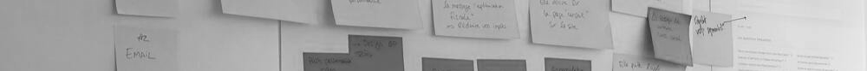



Core Capabilities
核心能力
COMPLIANCE
UNIFIED CX & EX
VISIBILITY & EVALUATION
Carrier Standard 電信商標準
SLA: 99.95% Uptime
服務級別協議 (SLA): 99.95% 正常運行時間
Industry Standard 行業標準
Awarded ISO20000, ISO27001 & ISO27017, and ISO9001 certificates
榮獲 ISO20000, ISO27001, ISO27017 及 ISO9001 認證
GDPR compliance
符合 GDPR 規格
Corporate Standard 企業標準
Multiple Domains
多網域
Data Retention
數據保留
Single Sign On (SSO)
單點登陸 (SSO)
Complete Convergence on One Interface
同一界面實現萬物融合
Identities (Customers & Employees)
身份 (客戶和員工）
Networks and Channels
網絡和渠道
Real-Time and Historical Data
實時和歴史數據
Multiple Domains
多網域
Multimedia
多媒體
Intelligent Routing
智能數由
3rd Party Integrations & APIs
第三方集成與 APIs
Communication & Information Sync.
通信和信息同步
Human-Machine Collaboration
人機協同
BI, AI, and Automation
商業智能 (BI)、人工智能和自動化
Real-time Visibility & Monitoring
實時可見性和監空
9

Slide 10
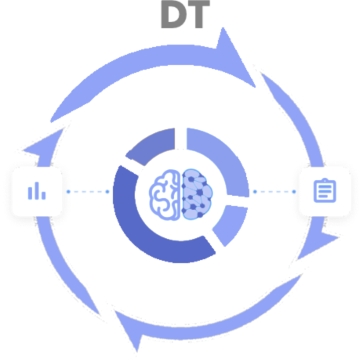
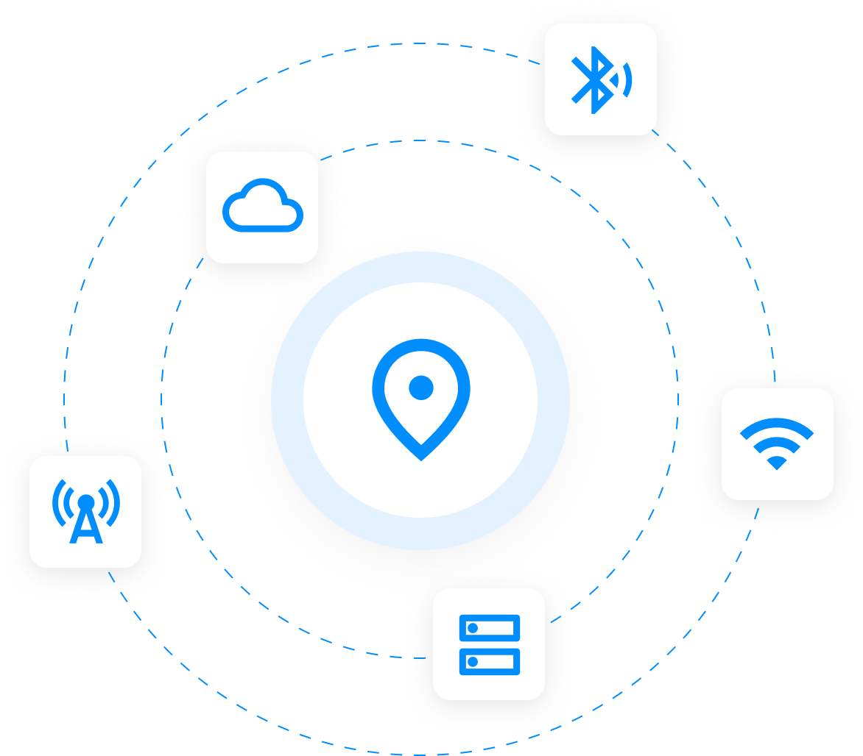
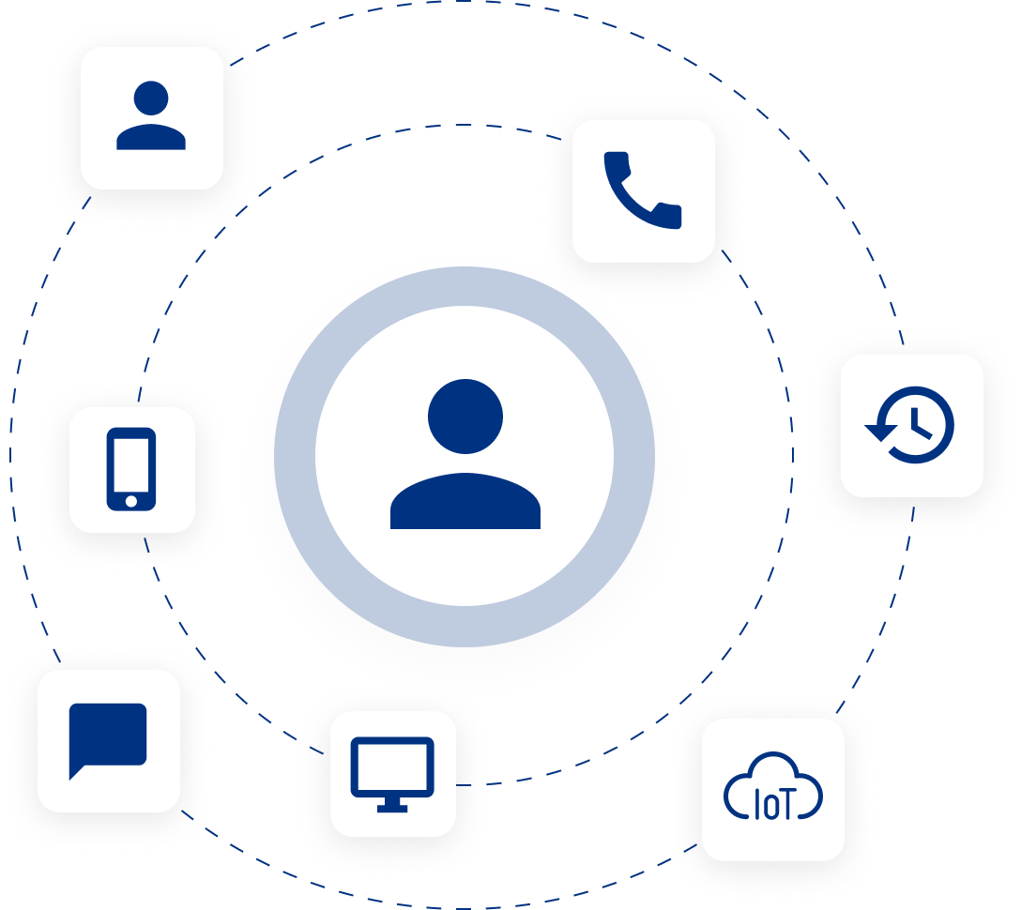




Connecting Neurons
Communication, Information, Operations & Data Technologies
萬物互聯
CT
IT, OT
＋
CRM
＝
CX
EX
Who are you
你是誰
Where are you
你在哪裡
What have you seen
What will you be doing
你看了甚麼 / 你將會做甚麼
Network ID (CX + EX) 網絡身份 (CX + EX)
Device Layer and Application Layer
設備層和應用層
Identical Personal Traits (Customers and Employees) 可辨識的個人特質 (客戶 + 員工)
Network Information 網絡信息
Signaling Layer 信令層
Channels and IP 渠道和 IP
OA Systems OA 系統
Visibility of Real-Time (200 ms) and Historical Data 實時可見性 (200毫秒) 和歴史數據
Categorisation of Actionable Data across Channels and Media 跨渠道和多媒體的可操作分類

Slide 11
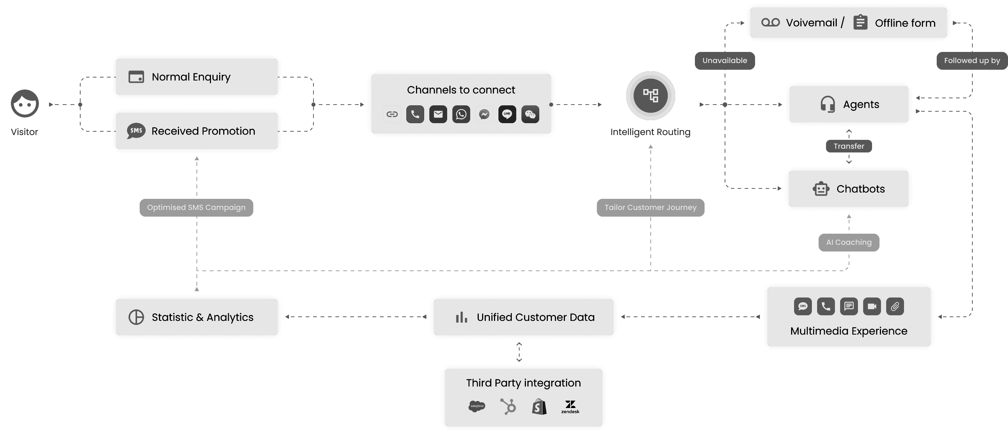
Our Solution – User Journey (E2E)
解決方案
3
Rich tools for intelligent routing can meet the need of simple to complex operation process of an enterprise.
1
Customer engages with the enterprise via the preferred channel directly
2
Enterprise can set the routing rules of this enquiry based on the captured information (e.g., location, time of day, languages)
1a
Customers receive promotion and trigger a new enquiry
6
In-depth customer data analysis provides support and guidance for your next major promotion and operation optimisation
Utilise multimedia communication to help in resolving customers’ problems more efficiently
4
5
Comprehensive, unified data and automation platform can integrate with the 3rd party tools you frequently use
Remark: 3rd party Integrations other than SF/WP/WIX are in roadmap 2023;
Chatbot supports 3rd party Chatbot: Microsoft QnA Maker & Google Dialogflow;
11

Slide 12
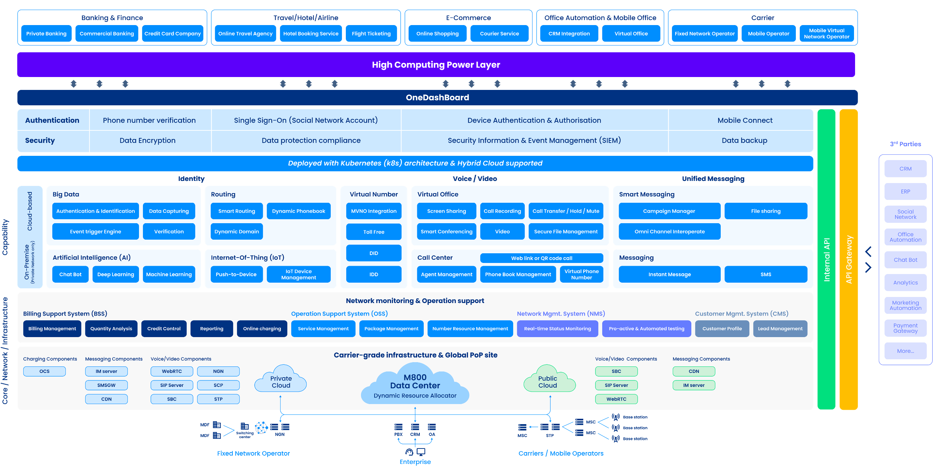
Digital Convergence Platform in Heterogeneous Multimedia Networks
數字融合智能平台

Slide 13
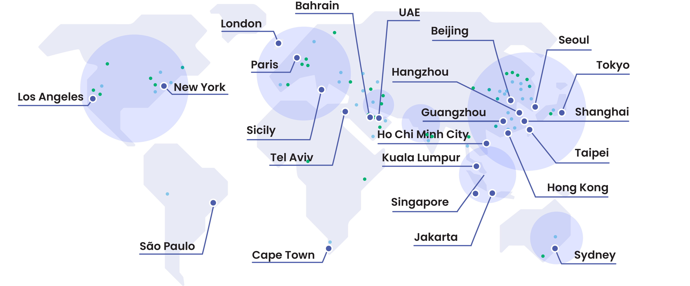
Global Distributed Infrastructure
全球分布式基礎架構
28+
160+
99.95%
Telco TDM
Public Cloud 公用雲
Private Cloud 私有雲
Hybrid Cloud 混合雲
Global PoP Sites
全球入網點
Tier-1 Carriers & Mobile Operators
一級電信運營商和移動運營商
SLA
服務級別協議
10

Slide 14





Global Security & Compliance Standards
國際認證
ISO 9001
Certified in Quality
Management Services 質量管理服務認証
ISO 27001
Certified in
Information Security 信息安全認証
ISO 20000
Certified in IT Service
Management IT服務管理認証
ISO 27017
Certified in Cloud Security and Data Protection 雲安全和數據保護認証
GDPR
General Data
Protection Regulation 符合通用數據保護條例
14

Slide 15
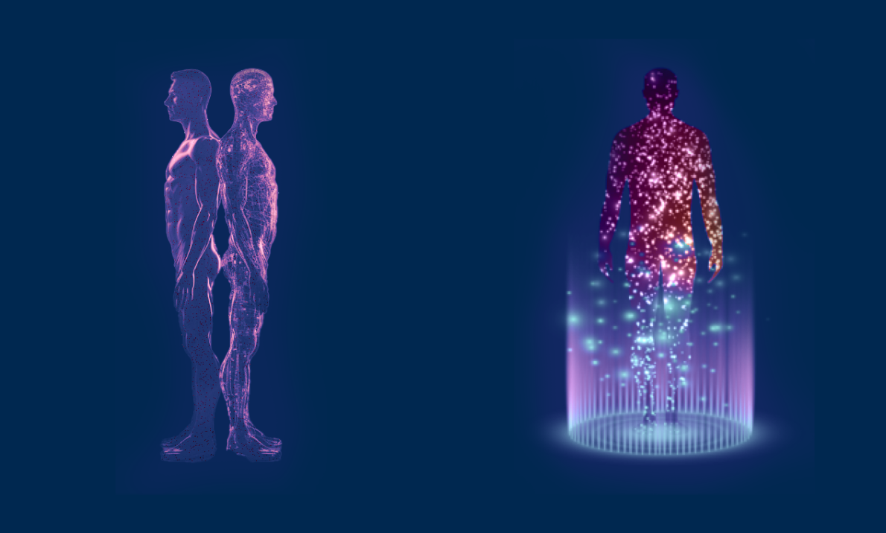
Present 現在 IoT
Future 未來 IoB
Human-Machine Collaboration / Convergence of Biological and Physical
人機協同 / 生物與物理融合
Internet of Bodies (IoB) –
Convergence of Mind and Intelligence
超級智慧人種 － 意念與智能融合
Notes:
Title - tbc

Slide 16
























































Key Customers
主要客戶
Banking and Finance
銀行與金融
Trusted by over 1,000 Multinational Corporations Globally
深受全球 1,000 多家跨國企業信任
Hotels and Travel
酒店與旅遊
Others
其他
15

Slide 17
THANK YOU!

